Slide 1
Machine Learning: a hands-on experience
UniCredit Quant Community
Gabriele Bonomi Boseggia, Fabio Colombo, Luca Mammi
Milan, June 7th, 2018

Slide 2
Welcome and thanks for being here!
While we start talking, let's get the systems up and running:
If you followed the instructions and want to run Jupyter Notebooks locally, please download the zip file with today's notebooks at one of these two links
OR
If you want to follow the lessons online please follow one of these links
goo.gl/jBryjq | goo.gl/VRtidt
goo.gl/1C2BLi | goo.gl/oaAMS6

Slide 3

Welcome and thanks for being here!
For any questions you have today, please join us on sli.do

Slide 4
AGENDA
Session 1: Introduction to Machine Learning
an introduction to Machine Learning
an introduction to the necessary R tools
some Machine Learning algorithms and models
…with code – hands on!
Session 2: Model Selection and Validation
more Machine Learning models
Model Selection and Validation
Model Training Strategies and Hyperparameter Tuning
…with code – hands on!
Session 3: Neural Networks
an introduction to Neural Networks (w/ code, hands on!)
some Deep Learning examples
…with code – hands on!

Slide 5

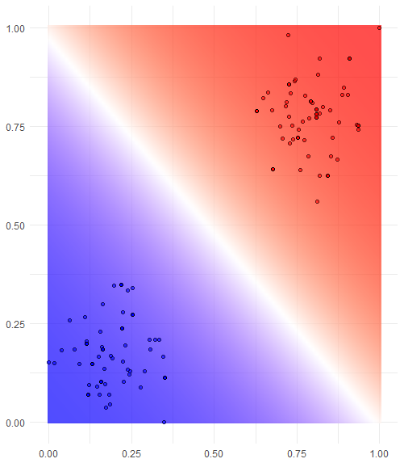
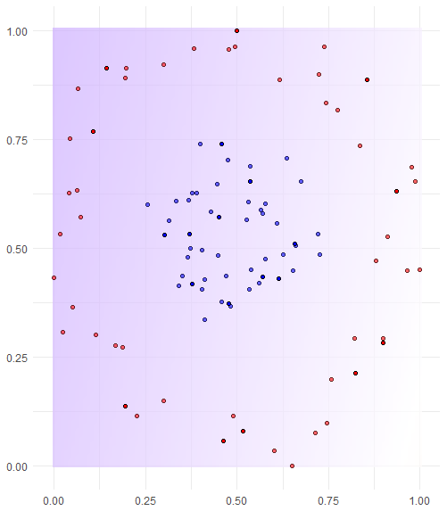
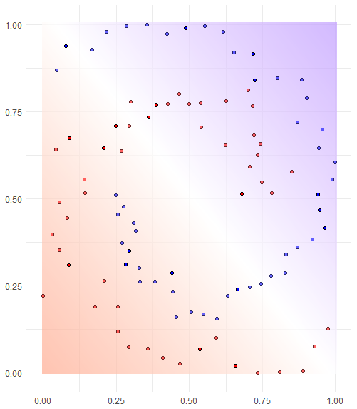
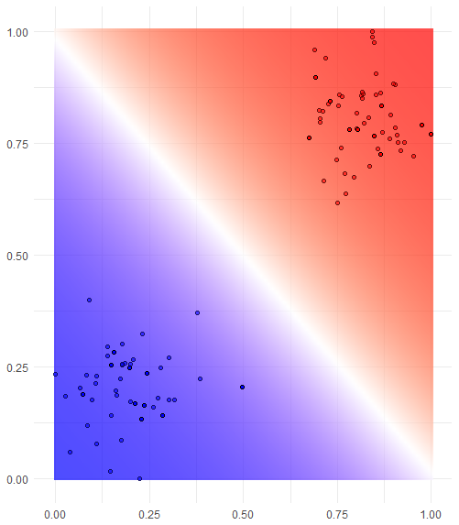
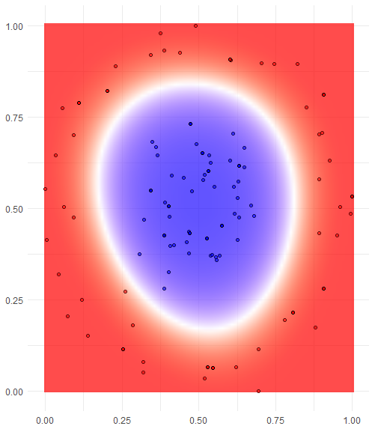
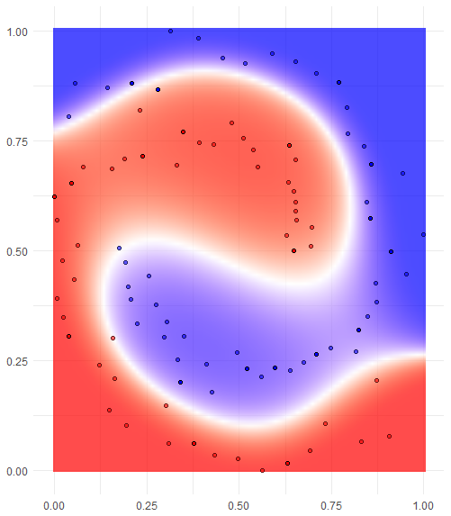
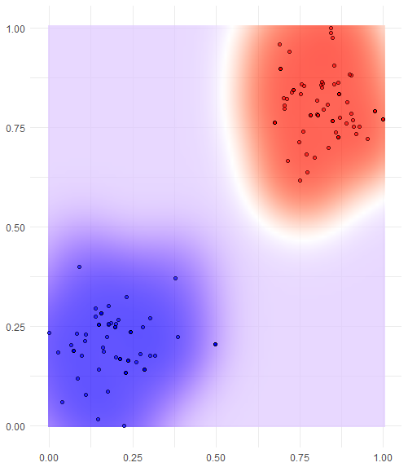
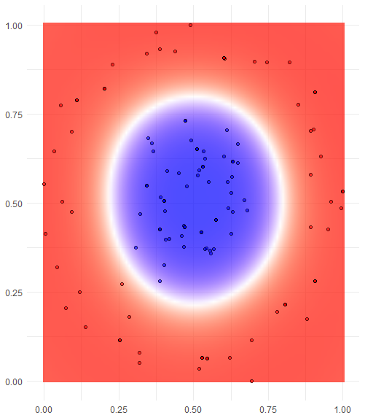
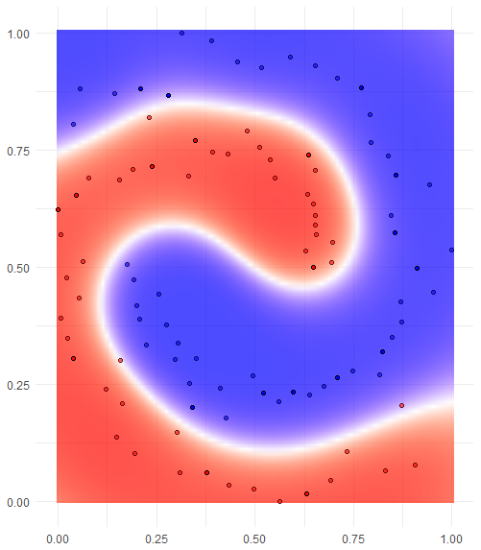
Machine Learning models: Support Vector Machine (SVM)
Hands on the code!
1_4_svm.ipynb
One of the most famous models: the Support Vector Machine (SVM)
Find the best class-separating
hyperplane in a d-dimensional space
Hard margin¹
Soft margin
It can be shown that equation of the
hyperplane is solely determined by
the support vectors, i.e. the points
the closest to such hyperplane
If the observations are not linearly
separable in the n-dimensional space
of the features…
Let’s try a higher dimensional space!
Isn’t this computationally expensive?
Not with the kernel trick²
The kernel can be
Linear
Polynomial
Radial
or anything³ you want it to be!
Linear
Polynomial
Radial
¹ No allowance for misclassification, this almost always results in overfitting
² https://en.wikipedia.org/wiki/Kernel_method
³ There are indeed some constraints, but it’s math and it’s boring

Slide 6
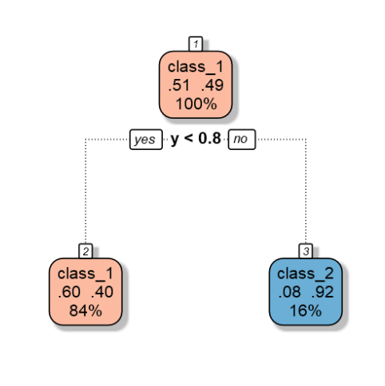
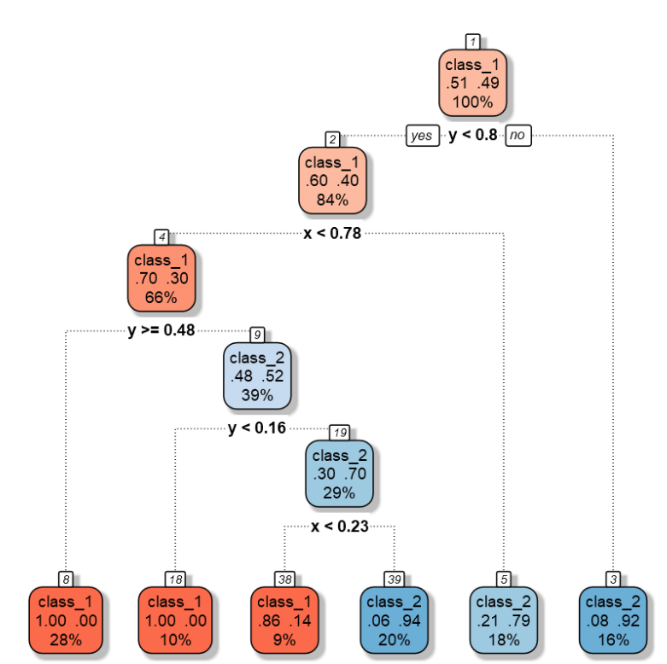
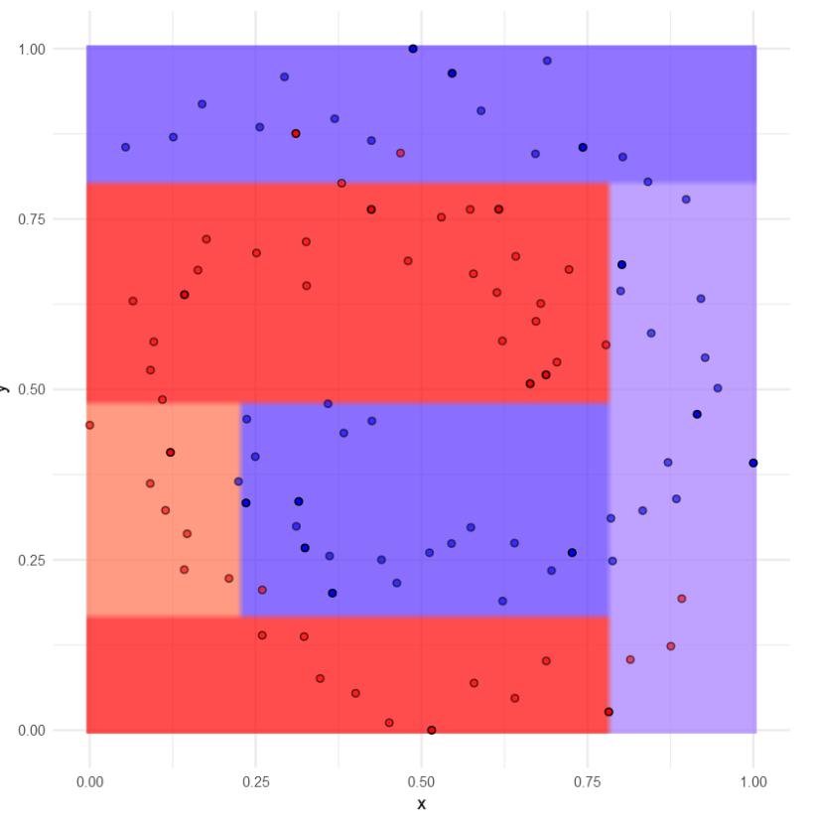
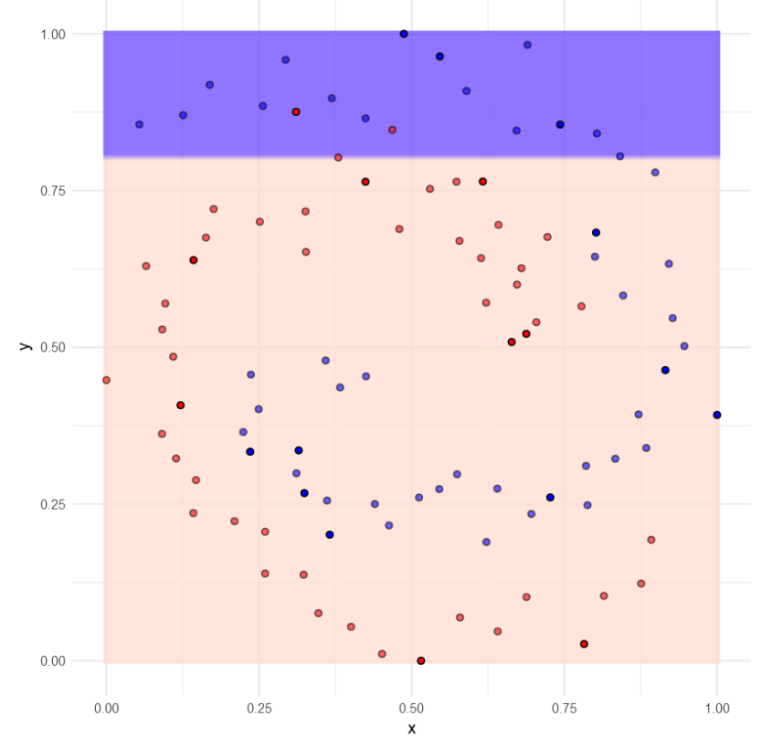
Machine Learning models: Decision Trees and Random Forest
Another famous model: Decision Trees
Classification (or regression) models in the form of a tree structure
The algorithm, ID3* iteratively breaks down a dataset into smaller subsets
Each time, the split is performed on the feature that maximize the information gain (i.e. entropy reduction)
* Iterative Dichotomizer http://hunch.net/~coms-4771/quinlan.pdf

Slide 7
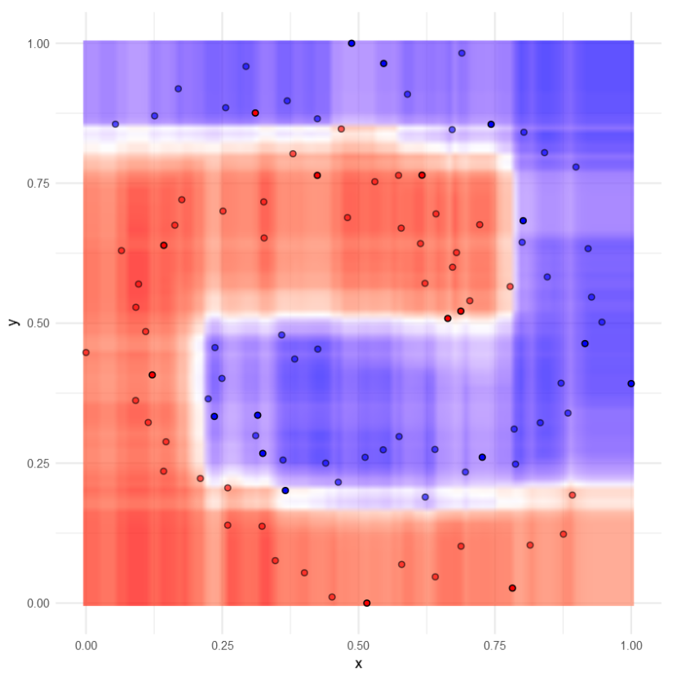
Machine Learning models: Decision Trees and Random Forest
Using Decision Trees we can define another very famous algorithm: Random Forest
The algorithm builds multiple decision trees on a random subset of features and weights the predicted outcomes together to get a more accurate and stable prediction.
Hands on the code!
1_5_dt.ipynb

Slide 8
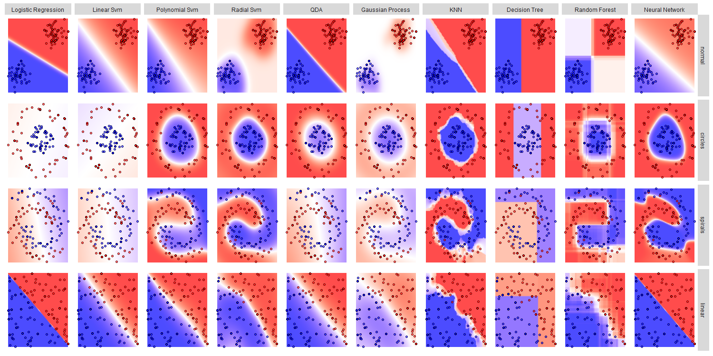
Machine Learning: model comparison
…but how do we choose the best model?

Slide 9
Machine Learning: model evaluation and selection
How do we choose the best model?
visualization is always recommended…
…know your data!
(only for few dimensions at the time, though!)
p-values
stepwise variable selection
AIC
BIC
…
and what about overfitting?
focus on the task
Hands on the code!
2_1_BiasVariance.ipynb
https://www.autodeskresearch.com/publications/samestats

Slide 10

Machine Learning: model performance
But is accuracy the best measure for model performance?
Are there any better options?
Let's ask Rose…
Hands on the code!
2_2_ModelPerformance.ipynb

Slide 11
Machine Learning: model selection and hyperparameter tuning
Now that we have a way to measure model performance, how do we select the best model?
And how do we tune its hyperparameters?
Hands on the code!
2_3_ModelSelection.ipynb
Hands on the code!
2_4_HyperparameterOptimization.ipynb

Slide 12

Let's give it all a try!
Let's try our hand by trying to detect some Credit Card Frauds!
Hands on the code!
2_5_CreditCardFraud.ipynb

